Slide 1
Data Analytics Foundations
Chapter 1.2 – Hands on Data Analytics for Everyone
北京师范大学-香港浸会大学联合国际学院
United International College

Slide 2
Background
Data Analytics Project Lifecycle
Example of Data Analytics Project
Project Understanding Phase
Data Understanding Phase
Data Format
Data Types
Assignment 1: In-class Essay
Assignment 2: In-class Quiz
Lab: Workflow in KNIME (Data Import Export)
Lab: Excel and CSV tables
APPENDIX: Introduction to KNIME

Slide 3

We Live in a World of Data…

Slide 4
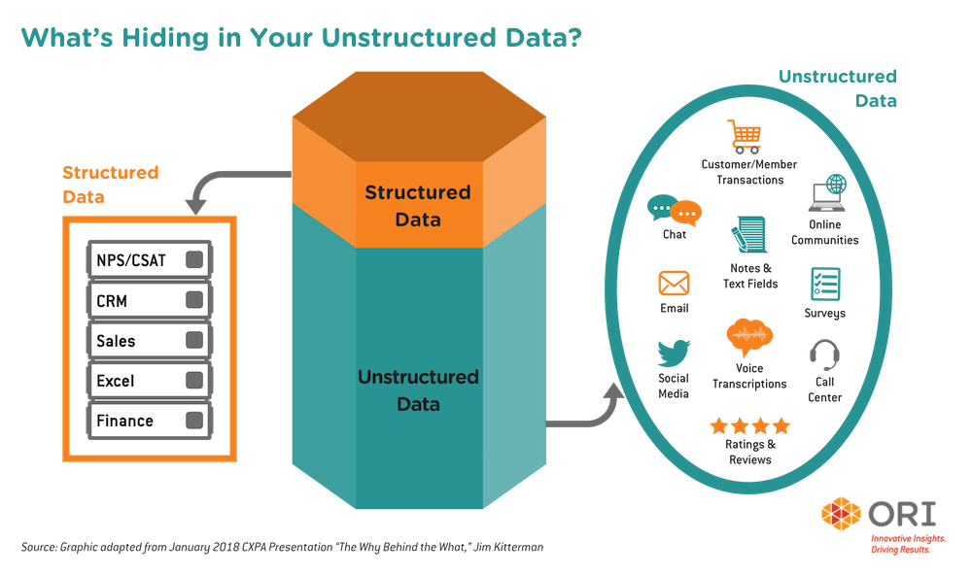
Structured and Unstructured Data

Slide 5
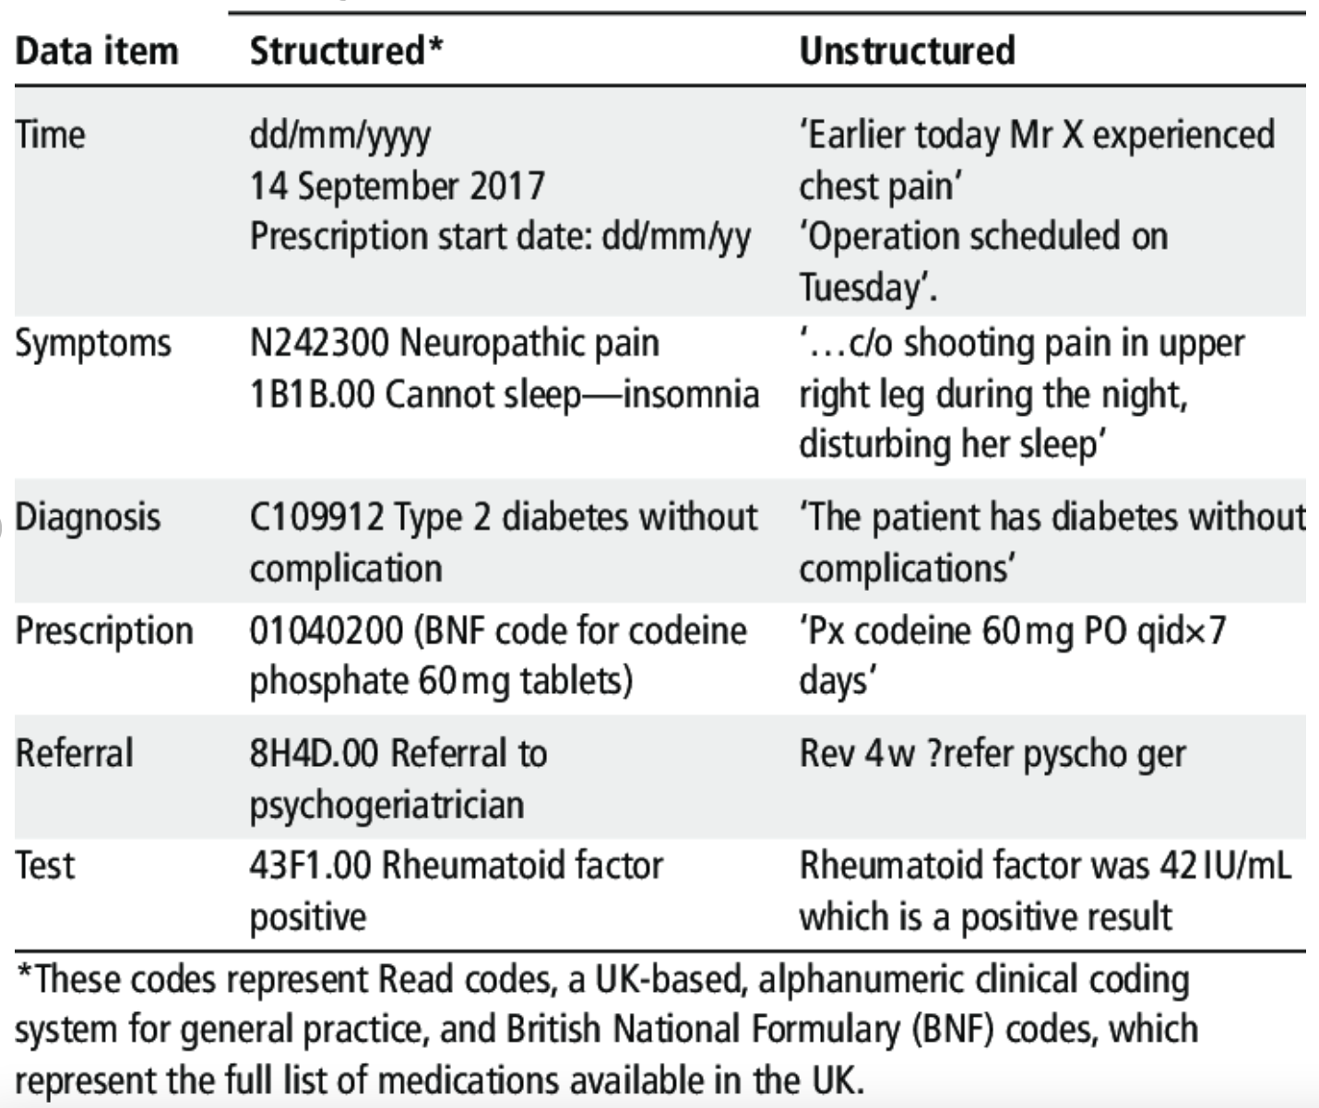
From Unstructured to Structured (Example 1)

Slide 6
From Unstructured to Structured (Example 2)
“Thomas said: For our course, we’ll have our final exam on 9:30, 6/December. The exam will last 2 hours, place will be T7-501. Please revise carefully.”
{
”date”: 06/12/2021
“time”: 09:30
“duration”: 120
“event”: “final exam”
“type”: “closed book”
“place”: “T7-501”
“course code”: “GFQR1013”
“course name”: “Hands on Data Analytics”
“lecturer”: “Thomas Canhao XU”
}

Slide 7
Common Structured Data Types
Comma-separated values (CSV)
Extensible Markup Language (XML)
JavaScript Object Notation (JSON)
Microsoft Excel (XLS)

Slide 8
Comma-separated Values
A comma-separated values (CSV) file is a delimited text file that uses a comma to separate values.
Each line of the file is a data record.
Each record consists of one or more attributes. The attributes are separated by commas
A CSV file typically stores tabular data (numbers and text) in plain text, in which case each line will have the same number of fields.

Slide 9
Comma-separated Values
Adjacent fields must be separated by a single comma.
However, "CSV" formats vary greatly in this choice of separator character.
In particular, in locales where the comma is used as a decimal separator, semicolon, TAB, or other characters are used instead.
1997,Ford,E350

Slide 10
Comma-separated Values
Any field may be quoted (that is, enclosed within double-quote characters), while some fields must be quoted, as specified in the following rules and examples:
"1997","Ford","E350"
Fields with embedded commas or double-quote characters must be quoted.
1997,Ford,E350,"Super, luxurious truck”
Each of the embedded double-quote characters must be represented by a pair of double-quote characters.
1997,Ford,E350,"Super, ""luxurious"" truck"

Slide 11
Example of Quotes in CSV
Year,Make,Model,Description,Price
1997,Ford,E350,"ac, abs, moon",3000.00
1999,Chevy,"Venture ""Extended Edition""","",4900.00
1999,Chevy,"Venture ""Extended Edition, Very Large""",,5000.00
1996,Jeep,Grand Cherokee,"MUST SELL! air, moon roof, loaded",4799.00

Slide 12
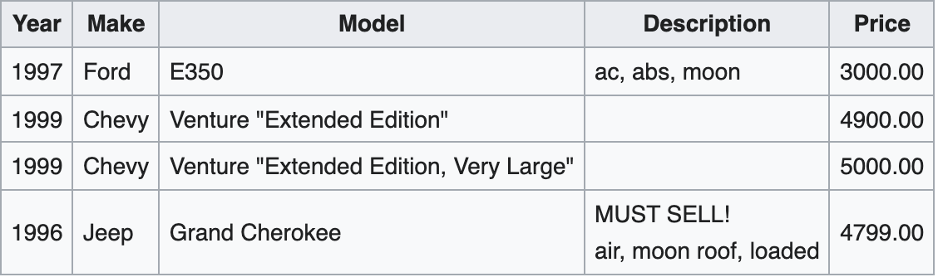
Example of Quotes in CSV

Slide 13
Comma-separated Values
The CSV file format is supported by almost all spreadsheets and database management systems.
Microsoft Excel also supports CSV.
CSV format is supported by libraries available for most programming languages.
Most provide some way to specify the field delimiter, decimal separator, character encoding, quoting conventions, date format, etc.
Put it simple, CSV is one of the most widely used data format for structured data.

Slide 14
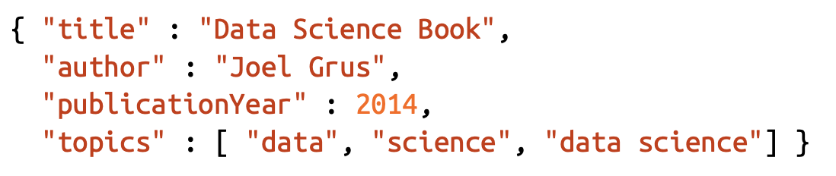
JSON
Because HTTP is a protocol for transferring text, the data you request through a web API needs to be serialized into a string format. Often this serialization uses JavaScript Object Notation (JSON). This data format makes their string representations easy to interpret

Slide 15
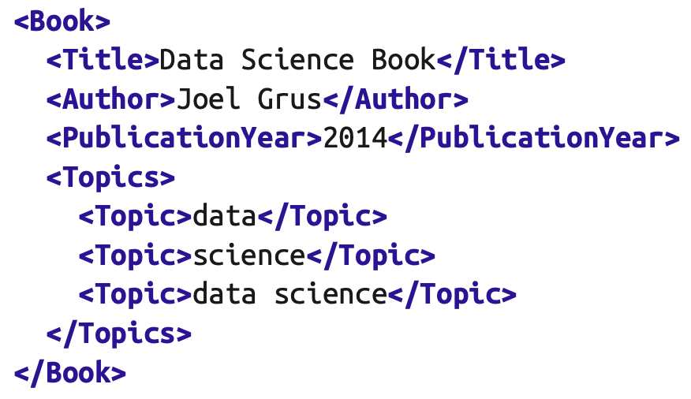
XML
Extensible Markup Language (XML) is a markup language that defines a set of rules for encoding documents in a format that is both human-readable and machine-readable.

Slide 16
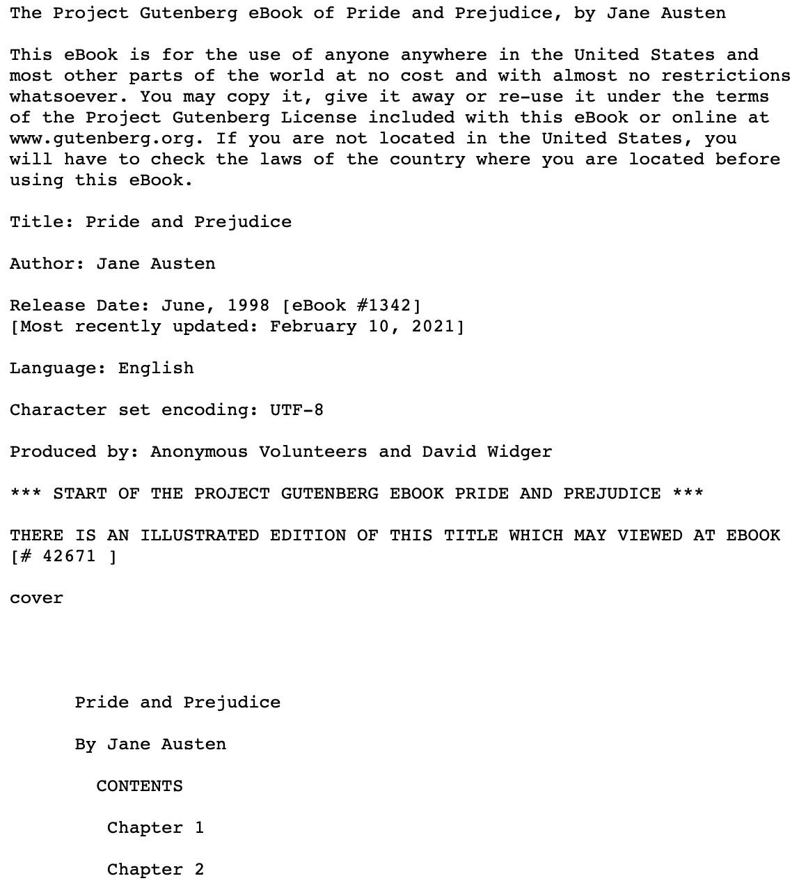
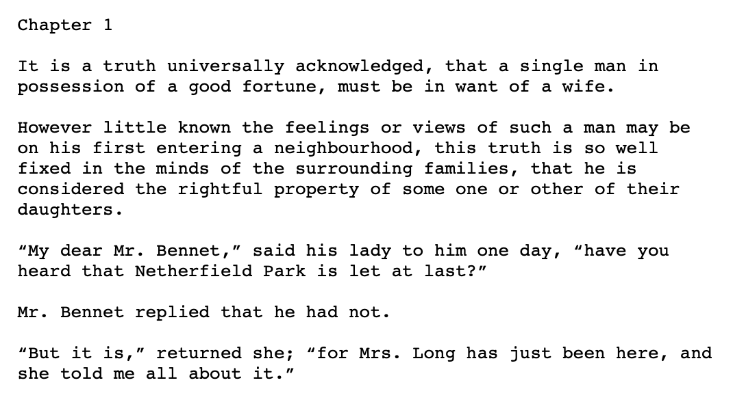
Example: Unstructured Text Data from the Web

Slide 17
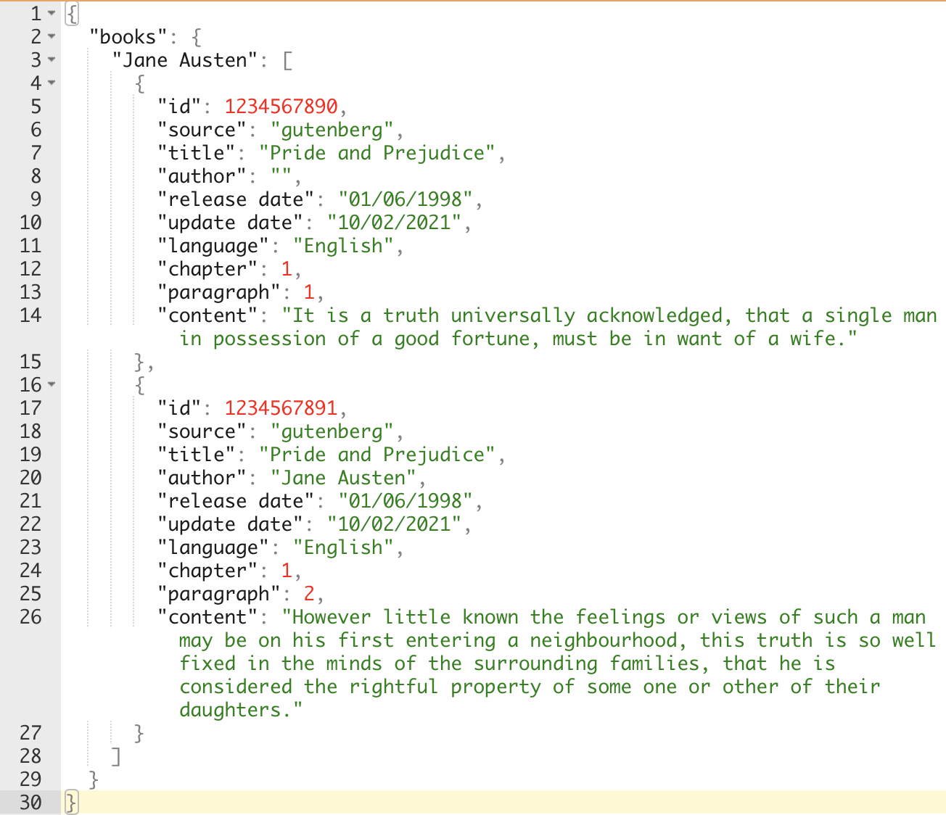
Example: Structured Text Data in JSON

Slide 18
Background
Data Analytics Project Lifecycle
Example of Data Analytics Project
Project Understanding Phase
Data Understanding Phase
Data Format
Data Types
Assignment 1: In-class Essay
Assignment 2: In-class Quiz
Lab: Workflow in KNIME (Data Import Export)
Lab: Excel and CSV tables
APPENDIX: Introduction to KNIME

Slide 19
Data Table: Attribute and Instances
Attributes, features, variables…
No | Sex | Age | Blood pr. | Height | Drug
1 | male | 20 | normal | 175,0 | A
2 | female | 73 | normal | 172,2 | B
3 | female | 37 | high | 163,8 | A
4 | male | 33 | low | 171,4 | B
5 | female | 48 | high | 165,9 | A
6 | male | 29 | normal | 182,3 | A
7 | female | 52 | normal | 167,2 | B
8 | male | 42 | low | 177,2 | B
9 | male | 61 | normal | 168,4 | B
10 | female | 30 | normal | 174,9 | A
Instances, records, data objects, entries…
Data can usually be described in terms of table or matrices
Sometimes data are spread among different table that need to be joined

Slide 20
Data Types
Categorical
Ordinal
Numeric
No | Sex | Age | Blood pr. | Height | Drug
1 | male | 20 | normal | 175,0 | A
2 | female | 73 | normal | 172,2 | B
3 | female | 37 | high | 163,8 | A
4 | male | 33 | low | 171,4 | B
5 | female | 48 | high | 165,9 | A
6 | male | 29 | normal | 182,3 | A
7 | female | 52 | normal | 167,2 | B
8 | male | 42 | low | 177,2 | B
9 | male | 61 | normal | 168,4 | B
10 | female | 30 | normal | 174,9 | A
Attributes differ for their scale type, according to the type of values that they can assume
Three scale types:
Categorical / Nominal
Ordinal
Numeric
Numeric
Categorical

Slide 21
Data Type: Categorical Attributes
Categorical (or Nominal) attributes have a finite set of possible values
Granularity must be taken into account
Hierarchical structure of the categories
e.g. shallow subdivision: food, non-food, drinks…
further subdivision for drinks: water, beer, wine…
Which level of granularity is appropriate?
Dynamic Domain
Some attributes have a fixed domain (e.g. months)
For other attributes the domain can change over time (e.g. the products in a catalogue)
Those attributes must be identified and handled
Categorical
No | Sex | Age | Blood pr. | Height | Drug
1 | male | 20 | normal | 175,0 | A
2 | female | 73 | normal | 172,2 | B
3 | female | 37 | high | 163,8 | A
4 | male | 33 | low | 171,4 | B
5 | female | 48 | high | 165,9 | A
6 | male | 29 | normal | 182,3 | A
7 | female | 52 | normal | 167,2 | B
8 | male | 42 | low | 177,2 | B
9 | male | 61 | normal | 168,4 | B
10 | female | 30 | normal | 174,9 | A
Categorical

Slide 22
Data Type: Ordinal Attributes
Ordinal
Ordinal attributes have an additional linear ordering offered by the domain
The ordering does not provide the distance between two object
e.g. for an attribute containing university degrees, we can state that a Ph.D is an higher degree than a M.Sc. and that this is higher than a B.Sc..
No | Sex | Age | Blood pr. | Height | Drug
1 | male | 20 | normal | 175,0 | A
2 | female | 73 | normal | 172,2 | B
3 | female | 37 | high | 163,8 | A
4 | male | 33 | low | 171,4 | B
5 | female | 48 | high | 165,9 | A
6 | male | 29 | normal | 182,3 | A
7 | female | 52 | normal | 167,2 | B
8 | male | 42 | low | 177,2 | B
9 | male | 61 | normal | 168,4 | B
10 | female | 30 | normal | 174,9 | A

Slide 23
Data Type: Numeric Attributes
The domain of numerical attributes are numbers. They can be
Discrete
e.g. age, count…
Represented as integer values
Continuous
e.g. height, weight, distance…
Represented as real values
Precision (rounding) has to be handled
The scale of numeric attributes can be:
Interval e.g. date
Ratio Scale e.g. distance, with a canonical zero value
Absolute Scale e.g. counting
Numeric continuous
No | Sex | Age | Blood pr. | Height | Drug
1 | male | 20 | normal | 175,0 | A
2 | female | 73 | normal | 172,2 | B
3 | female | 37 | high | 163,8 | A
4 | male | 33 | low | 171,4 | B
5 | female | 48 | high | 165,9 | A
6 | male | 29 | normal | 182,3 | A
7 | female | 52 | normal | 167,2 | B
8 | male | 42 | low | 177,2 | B
9 | male | 61 | normal | 168,4 | B
10 | female | 30 | normal | 174,9 | A
Numeric discrete

